Slide 1

AOLME Curriculum Session 7
MATERIALS DEVELOPED BY THE AOLME PROJECT AT THE UNIVERSITY OF NEW MEXICO, PLEASE DO NOT COPY OR DISTRIBUTE ANY OF THESE COPYRIGHTED TASKS WITHOUT PROPER AUTHORIZATION OF PROJECT

Slide 2


Level 1
SESSION 1: Basic of Raspberry PI and Linux-(motivational overview of projects-images, ls, cd) SESSION 2: Introduction to Python Programming (print, algebra, strings) SESSION 3: Algorithms: Loops, Conditionals, and Sequential Thinking (for and while loops, range commands, if statements, inequalities, sprite movement) SESSION 4: The Coordinate Plane and Black & White Images in Python SESSION 5: Binary and Hexadecimal number systems SESSION 6: Images and Their Components (histograms) SESSION 7: Creation of Images and Video FINAL PROJECT: VIDEO

Slide 3
Creation of images and videos
OBJECTIVES:
Create a single frame
Create a video using two frames
Create, move, and copy a video character
Review and discuss old video projects

Slide 4

Selected ACTIVITIES
Create a frame row by row
Make a video using two frames
Create a video character
Move and copy a video character
Open a project from Level I and discuss project ideas

Slide 5
Hints
Select a large block of text:
Hold down the Shift key and then move around the file with the arrow keys to select the text.
Select until the end of the line:
Windows: Hold down the Shift key and press the End key.
Linux on Pi: Hold down the Shift key and press the down arrow key.
Select until the beginning of the line:
Windows: Hold down the Shift key and press the Home key
Linux on Pi: Hold down the Shift key and press the up arrow key.
Cut, copy, and paste using the mouse:
Hold down the right mouse button to access cut, copy, and paste.
Cut, copy, and past using the keyboard:
Control+C for copy
Control+X for cut
Control+V for paste
Code to visualize a single video frame and comment when done:
im_show (frame1) # Make sure to replace frame1 with the frame that you want to see.
wait = input(“Press a key”) # Stops execution until you press a key
After you are done, you can comment out the code by placing a # at the beginning of each line.

Slide 6
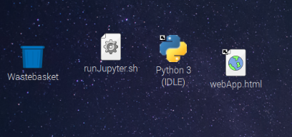
7.5. How to Program a Video?
Python IDLE. Open IDLE and navigate the
directory to /home/pi/AOLME/Session7/.
Then select a folder from a school and a
project to run. Run different projects.
2. Analyze: Let the facilitator discuss their project.
Go through the code and discuss the code with the rest of the group. Modify the code!
3. Replay: Find the commands vid_show(), frame_list, and fps and modify them.
4. Write: The team and summary expert will discuss what you learned in this session.
Which ideas do you want to implement in your project?
AOLME PROJECT - LEVEL 1- SESSION 7- 2018
MATERIALS DEVELOPED BY THE AOLME PROJECT AT THE UNIVERSITY OF NEW MEXICO, PLEASE DO NOT COPY OR DISTRIBUTE ANY OF THESE COPYRIGHTED TASKS WITHOUT PROPER AUTHORIZATION

Slide 7
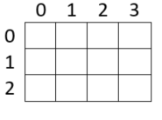
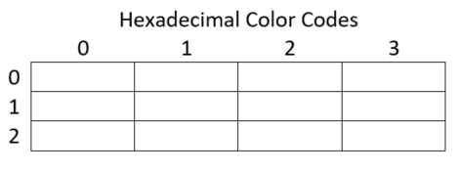
7.1. Create an Image (Frame) Row by Row
Create image. To create an image we use 3x4 color image using the provided page. 3x4 is the size of the image. Why?
2. Find hexadecimal codes for each color.
Use RRGGBB for each hex code.
E.g., Red is FF0000.
3. Create variables to store the colors that repeat in the frame.
Create variables for each color. For example:
r = “FF0000” # hex code for red
b = “0000FF” # hex code for blue
To create a red frame of size rows x cols, we use:
frame0 = np.array([[r]*cols for row in range (rows)])
4. Open Python IDLE and navigate the
directory to /home/pi/AOLME/Session7/.
Open the file FrameEx.py, run it and then
modify the code to create your image.
To specify your image, you will need to specify the size and enter it row-by-row. For example, for the 0th row for a four-column image, we use
frame0[0] = [r, b, r, b] # Modify!
AOLME PROJECT - LEVEL 1- SESSION 7- 2018
MATERIALS DEVELOPED BY THE AOLME PROJECT AT THE UNIVERSITY OF NEW MEXICO, PLEASE DO NOT COPY OR DISTRIBUTE ANY OF THESE COPYRIGHTED TASKS WITHOUT PROPER AUTHORIZATION

Slide 8
7.2. Make a Video Using Two Frames
Create two 2x2 video frames. Note the order:
Create the color variables
Create the video frame variable
Specify the frame row-by-row
2. Python IDLE. Open IDLE and navigate the
directory to /home/pi/AOLME/Session7/.
Run VideoEx1.py. Then modify the code to play
your two video frames.
Note that you specify your video using the frame_list variable:
frame_list = [frame0, frame1] # list of frames
3. Replay: Modify the video to play slower and faster. Modify the frame_list to play frame2 more times.
frame_list = [frame0, frame1] # list of frames
fps= 2 # frames per sec
play_video= vid_show(frame_list, fps)# play on screen
4. Analyze: Study VideoEx1.py and find the parts of the code that perform the following:
Import libraries
Define colors
Define frames
Define the list of frames
Play the video
Discuss the structure of the code.
AOLME PROJECT - LEVEL 1- SESSION 7- 2018
MATERIALS DEVELOPED BY THE AOLME PROJECT AT THE UNIVERSITY OF NEW MEXICO, PLEASE DO NOT COPY OR DISTRIBUTE ANY OF THESE COPYRIGHTED TASKS WITHOUT PROPER AUTHORIZATION

Slide 9
7.3. Create a video character
Python IDLE. Open IDLE and navigate the
directory to /home/pi/AOLME/Session7/.
Run VideoEx2.py. What do you see?
Note that the following code copies the contents of
variable frame0 into frame1:
frame1 = frame0.copy()
Analyze: Study the code and change a pixel.
Note that the following code changes pixels:
frame1[0][2] = b
frame1[3][2] = b
Analyze: Open and run the file im_fill_Ex.py.
Change the color and location of the rectangle:
start_row = 1
end_row = 2
start_col = 0
end_col = 1
im_fill(frame1, [start_row, end_row], [start_col, end_col], v)
4. Discuss: How would you create a character by specifying a row, a rectangle, or pixels?
AOLME PROJECT - LEVEL 1- SESSION 7- 2018
MATERIALS DEVELOPED BY THE AOLME PROJECT AT THE UNIVERSITY OF NEW MEXICO, PLEASE DO NOT COPY OR DISTRIBUTE ANY OF THESE COPYRIGHTED TASKS WITHOUT PROPER AUTHORIZATION

Slide 10
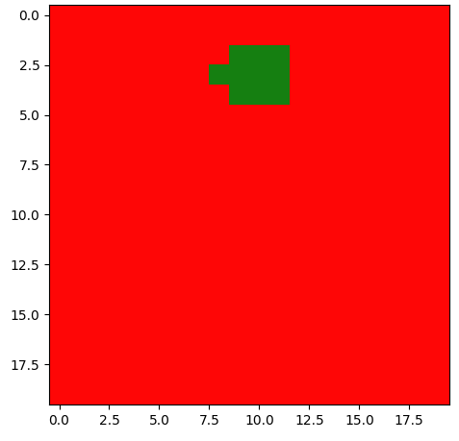
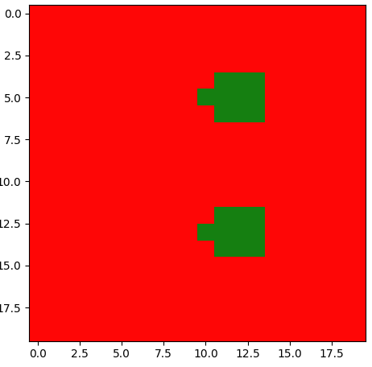
7.4. Move a Video Character
Python IDLE. Open IDLE and navigate the
directory to /home/pi/AOLME/Session7/.
Then run VideoDemo.py
2. Analyze and modify: Find the following code and discuss what it does. How does it work?
move_r = 2
for row in range(rows):
for col in range(cols-move_r):
frame2[row][col+move_r]=frame1[row][col]
Go through the code and discuss the code that produces the other 3 movements.
3. Copy a portion of a frame: Find the following line of code, uncomment it, and run:
#frame1[10:13,8:12] = frame1[2:5,8:12]
Note that rows 10, 11, and 12 and columns 8, 9, 10, 11
are copied.
Like for range(), you stop at row=13, column=12.
Thus, row=13 and column=12 are NOT copied.
4. Discuss:
How can you use move and copy to make an interesting video?
AOLME PROJECT - LEVEL 1- SESSION 7- 2018
MATERIALS DEVELOPED BY THE AOLME PROJECT AT THE UNIVERSITY OF NEW MEXICO, PLEASE DO NOT COPY OR DISTRIBUTE ANY OF THESE COPYRIGHTED TASKS WITHOUT PROPER AUTHORIZATION

Slide 11

7.5. Discuss Level 1 Projects
Resources for the Activity
Recommended steps for the Activity
Activity Card
Folder: /home/pi/AOLME/Session7/ and projects under this directory.
2. Raspberry Pi kit
3. Student journal
Make sure students ‘play’ with the code.
Make sure co-facilitator discusses their code.
Let the students ask questions about the project that the co-facilitator worked on. Try not to tell them, instead ask questions to prompt their thinking.
Have students debrief and write about what they learned in session 7.
Evaluate how did the team roles work?
Discussion Expert: Leads the team discussion asking questions about what the session is about.
Fair Participation Expert: makes sure of fair participation of everyone.
Hardware Setup/Teardown Expert: in charge of setting up & putting away materials and computer equipment.
Summary Expert: summarizes and records team questions and what the teams has learned.
Start discussing ideas for the project.
AOLME PROJECT - LEVEL 1- SESSION 7- 2018
MATERIALS DEVELOPED BY THE AOLME PROJECT AT THE UNIVERSITY OF NEW MEXICO, PLEASE DO NOT COPY OR DISTRIBUTE ANY OF THESE COPYRIGHTED TASKS WITHOUT PROPER AUTHORIZATION

